Slide 1
Neural Network Layers in Pytorch
2018.12.25
For basic network model implementation

Slide 2
Why Pytorch
Combined Caffe and Torch
Dynamic computational graph
Looks exactly like numpy, and write in natural Python
Support ONNX
More important, recently Facebook opensource the NLP toolkit base on Pytorch——Pytext

Slide 3
A zoo of frameworks!
PaddlePaddle
(Baidu)
Chainer
Caffe
(UC Berkeley)
Caffe2
(Facebook)
MXNet
(Amazon)
Developed by U Washington, CMU, MIT, Hong Kong U, etc but main framework of choice at AWS
CNTK
(Microsoft)
Torch
(NYU / Facebook)
PyTorch
(Facebook)
Deeplearning4j
Theano
(U Montreal)
TensorFlow
(Google)
And others...
Fei-Fei Li & Justin Johnson & Serena Yeung
Fei-Fei Li & Justin Johnson & Serena Yeung Lecture 8 - April 26, 2018

Slide 4
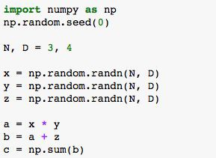
Computational Graphs
Numpy
x y z
*
a
+
b
Σ
c
Fei-Fei Li & Justin Johnson & Serena Yeung

Slide 5
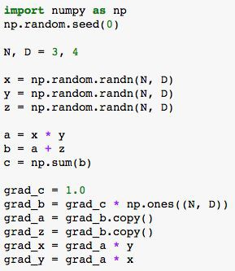
Computational Graphs
Numpy
x y z
*
a
+
b
Σ
c
Fei-Fei Li & Justin Johnson & Serena Yeung

Slide 6
Computational Graphs
Numpy
Good:
- Clean API, easy to write numeric code
x y z
*
a
+
Bad:
b
Have to compute our own gradients
Can’t run on GPU
Σ
c
Fei-Fei Li & Justin Johnson & Serena Yeung

Slide 7
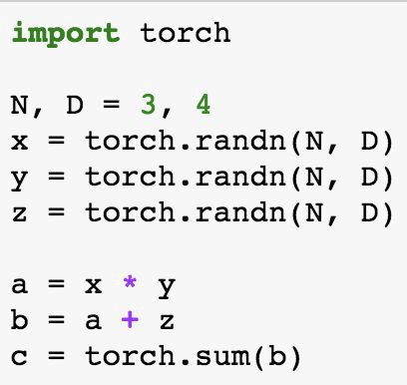
Computational Graphs
Numpy
PyTorch
x y z
*
a
+
b
Σ
c
Looks exactly like numpy!
Fei-Fei Li & Justin Johnson & Serena Yeung

Slide 8
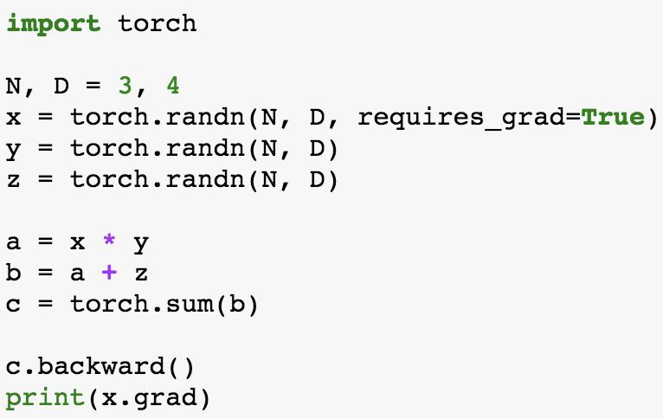
Computational Graphs
Numpy
PyTorch
x y z
*
a
+
b
Σ
c
PyTorch handles gradients for us!
Fei-Fei Li & Justin Johnson & Serena Yeung

Slide 9
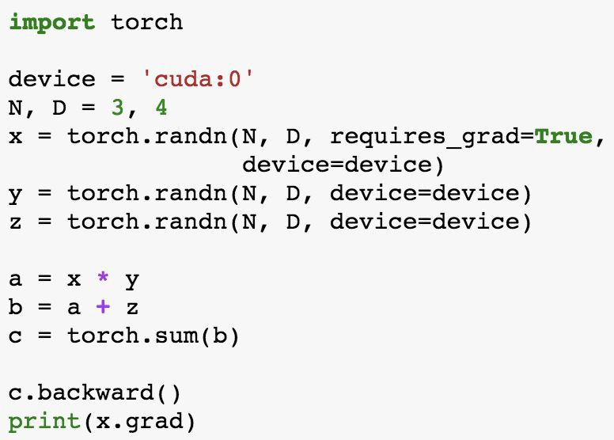
Computational Graphs
Numpy
PyTorch
x y z
*
a
+
b
Σ
c
Trivial to run on GPU - just construct arrays on a different device!
Fei-Fei Li & Justin Johnson & Serena Yeung

Slide 10
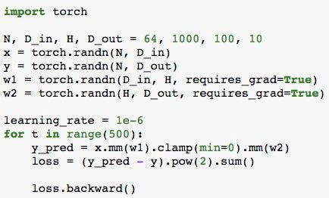
PyTorch: Dynamic Computation Graphs
Fei-Fei Li & Justin Johnson & Serena Yeung
10

Slide 11
PyTorch: Dynamic Computation Graphs
x
w1
w2
y
Create Tensor objects
Fei-Fei Li & Justin Johnson & Serena Yeung
11

Slide 12


PyTorch: Dynamic Computation Graphs
x
w1
w2
y
mm
clamp
mm
y_pred
Build graph data structure AND perform computation
Fei-Fei Li & Justin Johnson & Serena Yeung
12

Slide 13
PyTorch: Dynamic Computation Graphs
x
w1
w2
y
mm
clamp
mm
y_pred
-
Build graph data structure AND perform computation
pow
sum
loss
Fei-Fei Li & Justin Johnson & Serena Yeung
13

Slide 14
PyTorch: Dynamic Computation Graphs
x
w1
w2
y
mm
clamp
mm
y_pre
d
-
Search for path between loss and w1, w2 (for backprop) AND perform computation
pow
sum
loss
Fei-Fei Li & Justin Johnson & Serena Yeung
14

Slide 15
PyTorch: Dynamic Computation Graphs
x
w1
w2
y
Throw away the graph, backprop path, and rebuild it from scratch on every iteration
Fei-Fei Li & Justin Johnson & Serena Yeung
15

Slide 16
PyTorch: Dynamic Computation Graphs
x
w1
w2
y
mm
clamp
mm
y_pred
Build graph data structure AND perform computation
Fei-Fei Li & Justin Johnson & Serena Yeung
16

Slide 17
PyTorch: Dynamic Computation Graphs
x
w1
w2
y
mm
clamp
mm
y_pred
-
Build graph data structure AND perform computation
pow
sum
loss
Fei-Fei Li & Justin Johnson & Serena Yeung
17

Slide 18
PyTorch: Dynamic Computation Graphs
x
w1
w2
y
mm
clamp
mm
y_pre
d
-
Search for path between loss and w1, w2 (for backprop) AND perform computation
pow
sum
loss
Fei-Fei Li & Justin Johnson & Serena Yeung
18

Slide 19
PyTorch: Dynamic Computation Graphs
Building the graph and computing the graph happen at the same time.
Seems inefficient, especially if we are building the same graph over and over again...
Fei-Fei Li & Justin Johnson & Serena Yeung
19

Slide 20
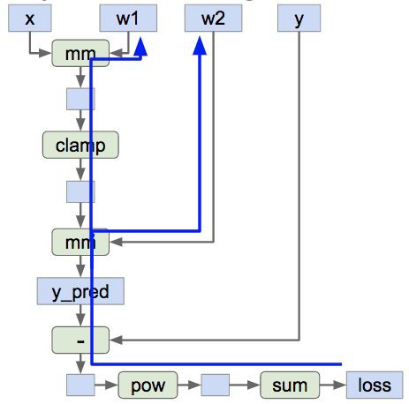
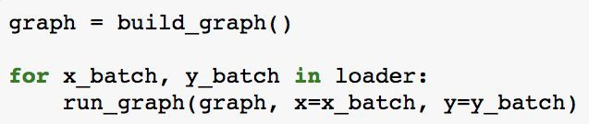
Static Computation Graphs
Alternative: Static graphs
Step 1: Build computational graph describing our computation (including finding paths for backprop)
Step 2: Reuse the same graph on every iteration
Fei-Fei Li & Justin Johnson & Serena Yeung
20

Slide 21
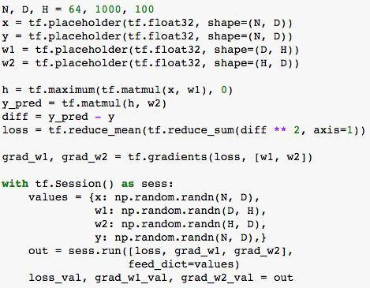
TensorFlow: Neural Net
First define
computational graph
Then run the graph many times
Fei-Fei Li & Justin Johnson & Serena Yeung

Slide 22
TensorFlow: Neural Net
Create placeholders for input x, weights w1 and w2, and targets y
Fei-Fei Li & Justin Johnson & Serena Yeung

Slide 23
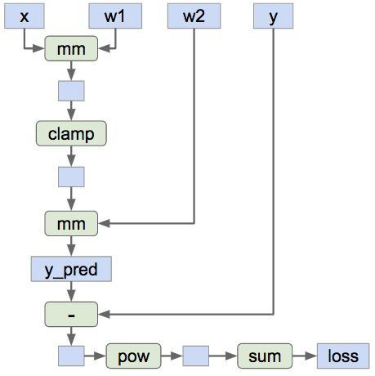
TensorFlow: Neural Net
Forward pass: compute prediction for y and loss. No computation - just building graph
Fei-Fei Li & Justin Johnson & Serena Yeung

Slide 24
TensorFlow: Neural Net
Tell TensorFlow to compute loss of gradient with respect to w1 and w2. No compute - just building the graph
Fei-Fei Li & Justin Johnson & Serena Yeung

Slide 25
TensorFlow: Neural Net
Find paths between loss and w1, w2
Fei-Fei Li & Justin Johnson & Serena Yeung

Slide 26
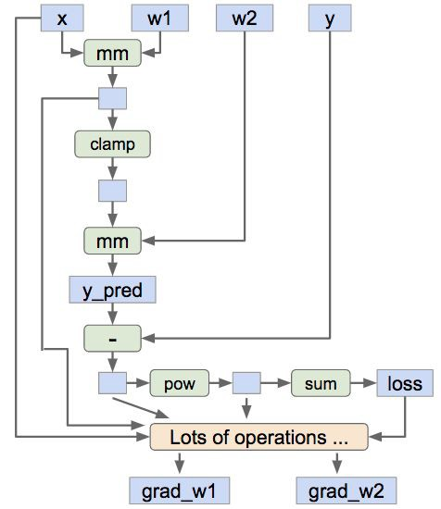
TensorFlow: Neural Net
Add new operators to the graph which compute grad_w1 and grad_w2
Fei-Fei Li & Justin Johnson & Serena Yeung

Slide 27
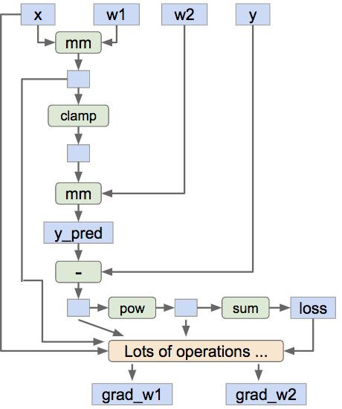
TensorFlow: Neural Net
Now done building our graph, so we enter a session so we can actually run the graph
Fei-Fei Li & Justin Johnson & Serena Yeung
₉9₆6

Slide 28
TensorFlow: Neural Net
Create numpy arrays that will fill in the placeholders above
Fei-Fei Li & Justin Johnson & Serena Yeung

Slide 29
TensorFlow: Neural Net
Run the graph: feed in the numpy arrays for x, y, w1, and w2; get numpy arrays for loss, grad_w1, and grad_w2
Fei-Fei Li & Justin Johnson & Serena Yeung

Slide 30
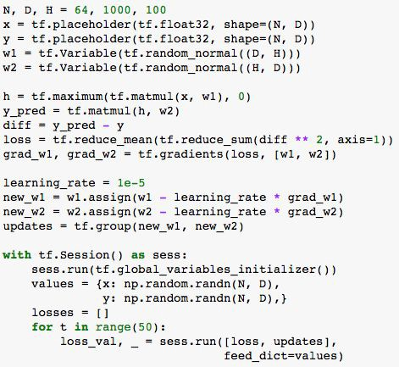
Static vs Dynamic Graphs
TensorFlow: Build graph once, then run many times (static)
PyTorch: Each forward pass defines a new graph (dynamic)
Build graph
Run each iteration
New graph each iteration
Fei-Fei Li & Justin Johnson & Serena Yeung

Slide 31


Static vs Dynamic: Optimization
With static graphs, framework can optimize the graph for you before it runs!
The graph you wrote
Equivalent graph with
fused operations
Conv
ReLU
Conv
ReLU
Conv
ReLU
Conv+ReLU
Conv+ReLU
Conv+ReLU
Fei-Fei Li & Justin Johnson & Serena Yeung

Slide 32
Static vs Dynamic: Serialization
Static
Once graph is built, can serialize it and run it without the code that built the graph!
Dynamic
Graph building and execution are intertwined, so always need to keep code around
Fei-Fei Li & Justin Johnson & Serena Yeung

Slide 33
Static vs Dynamic: Conditional
w1 * x w2 * x
if z > 0 otherwise
y =
Fei-Fei Li & Justin Johnson & Serena Yeung

Slide 34
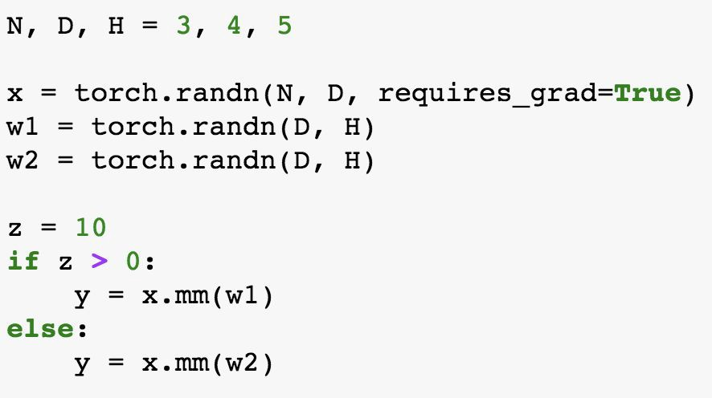
Static vs Dynamic: Conditional
w1 * x w2 * x
if z > 0 otherwise
y =
PyTorch: Normal Python
Fei-Fei Li & Justin Johnson & Serena Yeung

Slide 35
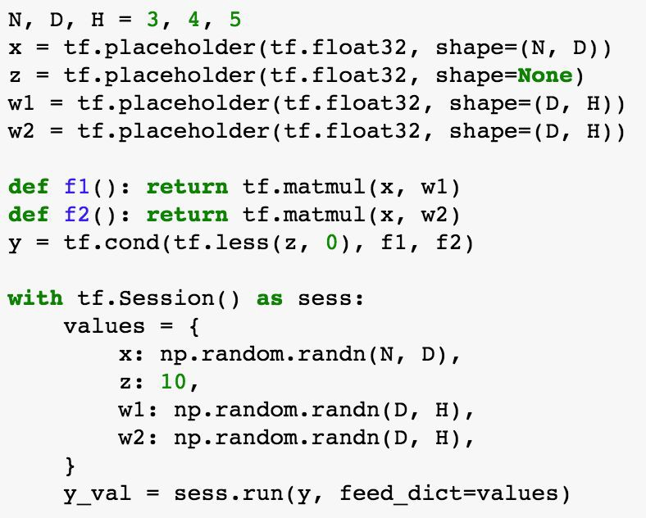

Static vs Dynamic: Conditional
TensorFlow: Special TF
w1 * x w2 * x
if z > 0 otherwise
y =
control flow operator!
PyTorch: Normal Python
Fei-Fei Li & Justin Johnson & Serena Yeung

Slide 36
Static vs Dynamic: Loops
w
y_{t} = (y_{t-1}+ x_{t}) * w
y₀
+
*
+
*
+
*
x₁
x₂
x₃
Fei-Fei Li & Justin Johnson & Serena Yeung

Slide 37
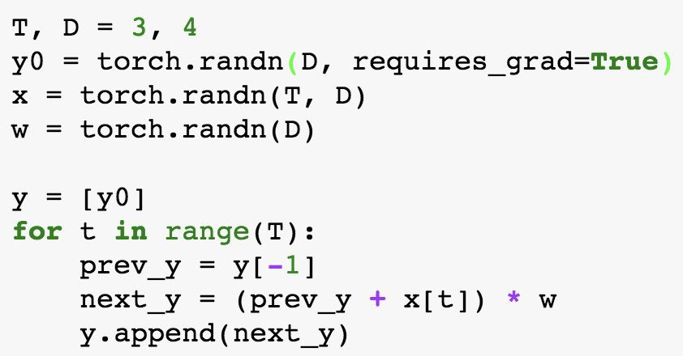
Static vs Dynamic: Loops
w
y_{t} = (y_{t-1}+ x_{t}) * w
PyTorch: Normal Python
y₀
+
*
+
*
+
*
x₁
x₂
x₃
Fei-Fei Li & Justin Johnson & Serena Yeung

Slide 38
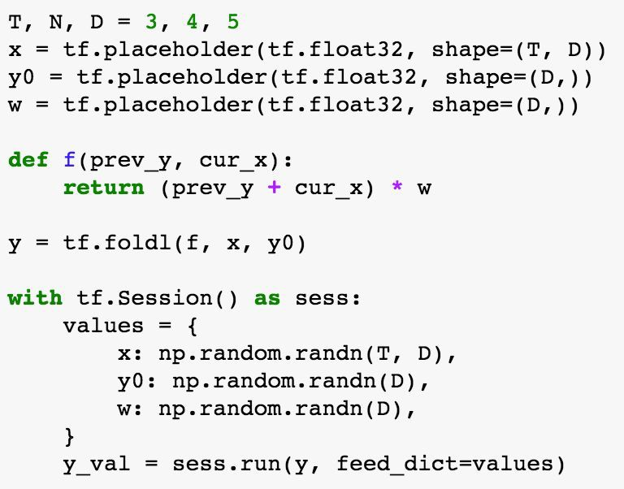
Static vs Dynamic: Loops
TensorFlow: Special TF control flow
y_{t} = (y_{t-1}+ x_{t}) * w
PyTorch: Normal Python
Fei-Fei Li & Justin Johnson & Serena Yeung

Slide 39
ONNX Support
ONNX is an open-source standard for neural network models
Goal: Make it easy to train a network in one framework, then run it in another framework
Supported by PyTorch, Caffe2, Microsoft CNTK, Apache MXNet https://github.com/onnx/onnx
Fei-Fei Li & Justin Johnson & Serena Yeung

Slide 40
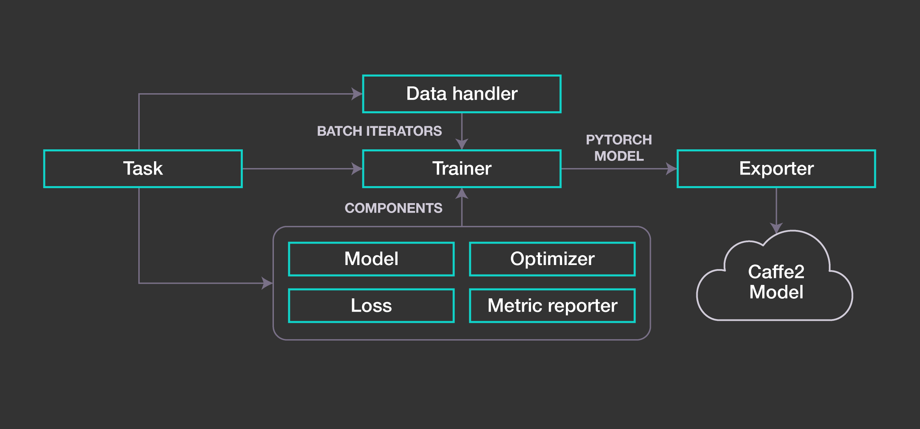
PyText workflow

Slide 41
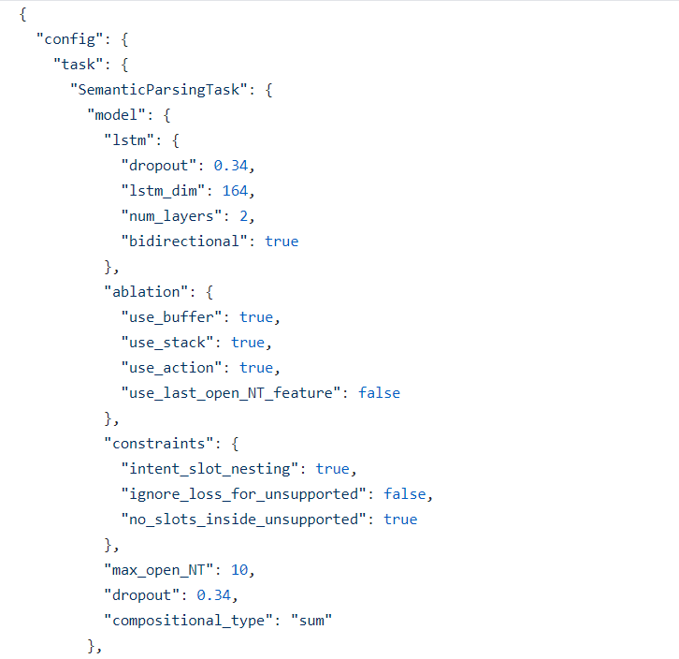
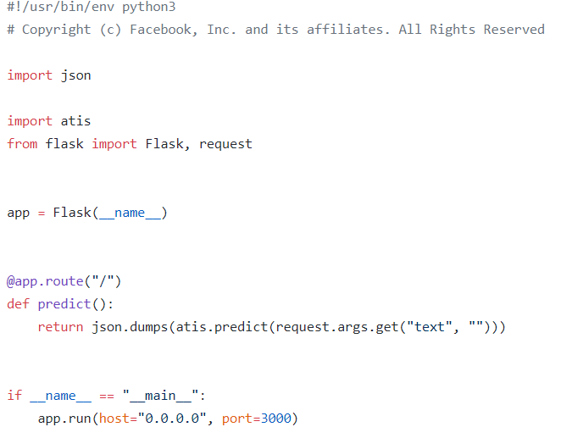

Slide 42
Torch.nn
The nn modules in PyTorch provides us a higher level API to build and train deep network.

Slide 43
torch.nn
Containers
Linear layers
Convolution layers
Pooling layers
Recurrent layers
Dropout layers
Normalization layers
Non-linear activations
Loss functions
Padding layers
Sparse layers
Distance functions
Vision layers
Utilities

Slide 44
Containers
Module
Sequential
ModuleList
ParameterList

Slide 45
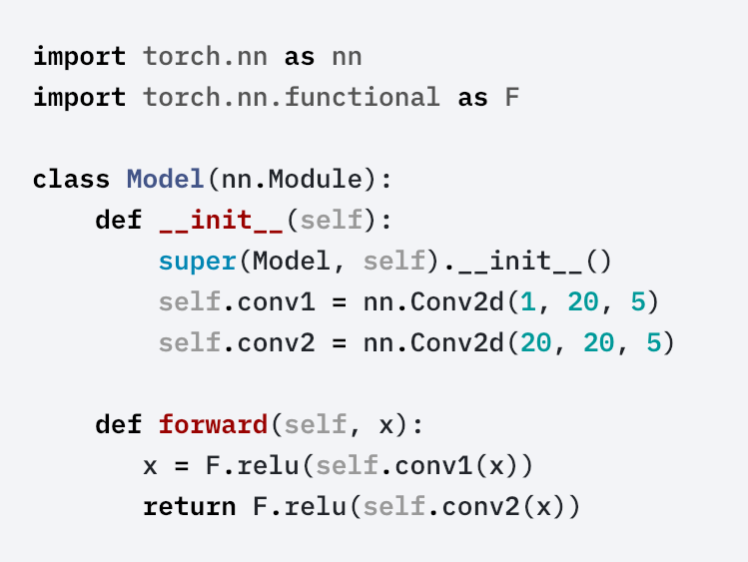
Module
Base class for all neural network modules.
Your models should also subclass this class.
Modules can also contain other Modules, allowing to nest them in a tree structure. You can assign the submodules as regular attributes:

Slide 46
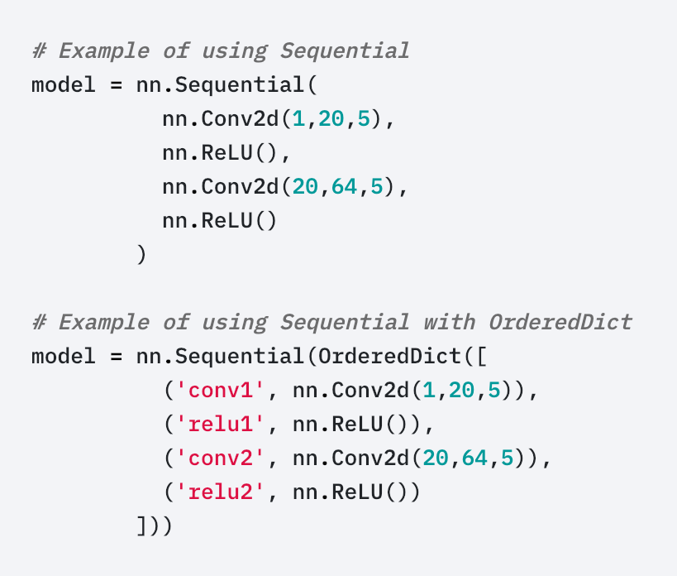
Sequential
A sequential container. Modules will be added to it in the order they are passed in the constructor.
Alternatively, an ordered dict of modules can also be passed in.

Slide 47
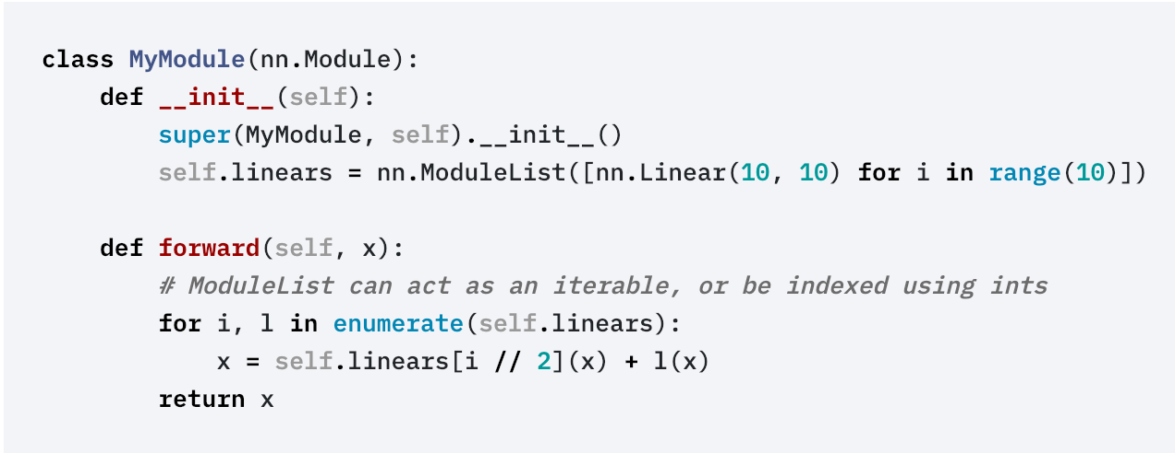
ModuleList
ModuleList can be indexed like a regular Python list, but modules it contains are properly registered, and will be visible by all Module methods.

Slide 48
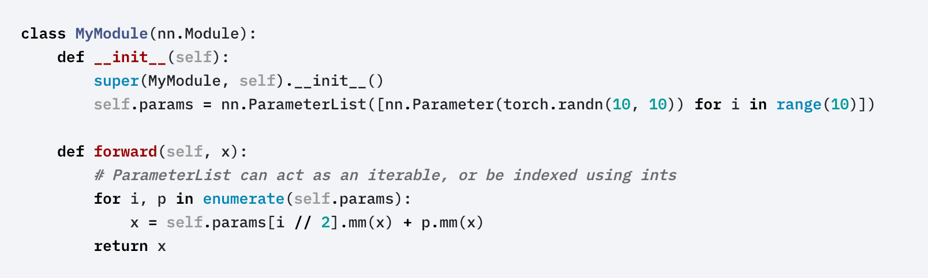
ParameterList
ParameterList can be indexed like a regular Python list, but parameters it contains are properly registered, and will be visible by all Module methods.

Slide 49
Linear layers
Linear
Bilinear

Slide 50
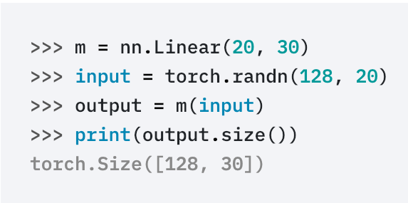
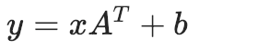
Linear
Applies a linear transformation to the incoming data:
torch.nn.Linear(in_features, out_features, bias=True)
Parameters:
in_features – size of each input sample
out_features – size of each output sample
bias – If set to False, the layer will not learn an additive bias. Default: True

Slide 51
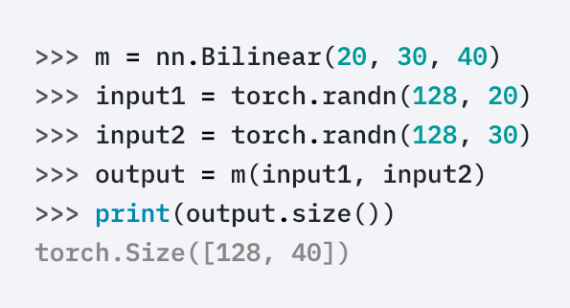
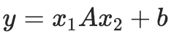
Bilinear
Applies a linear transformation to the incoming data:
torch.nn.Bilinear(in1_features, in2_features, out_features, bias=True)
Parameters:
in1_features – size of each first input sample
in2_features – size of each second input sample
out_features – size of each output sample
bias – If set to False, the layer will not learn an additive bias. Default: True

Slide 52
Convolution Layers
Conv1d
Conv2d
Conv3d
ConvTranspose1d
ConvTranspose2d
ConvTranspose3d

Slide 53
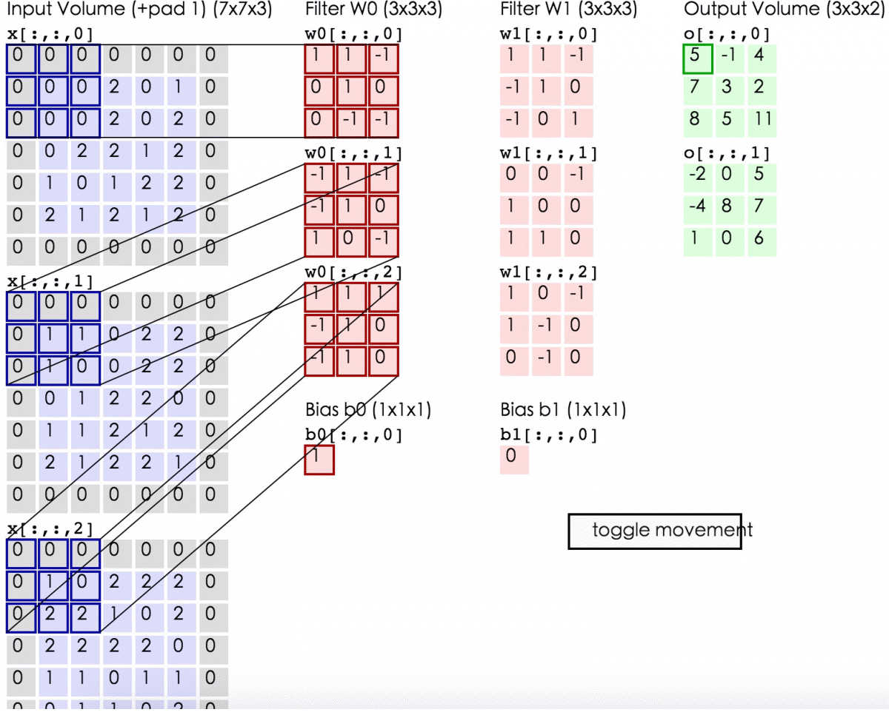

Slide 54
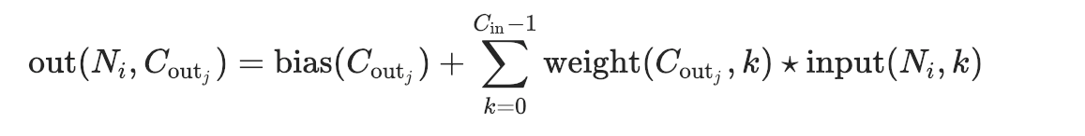
Conv2d
torch.nn.Conv2d(in_channels, out_channels, kernel_size, stride=1, padding=0, dilation=1, groups=1, bias=True)
In the simplest case, the output value of the layer with input size (N,C_{in}​,H,W) and output (N,C_{out}​,H_{out}​,W_{out}​) can be precisely described as:
where ⋆ is the valid 2D cross-correlation operator, N is a batch size, C denotes a number of channels, H is a height of input planes in pixels, and W is width in pixels.

Slide 55
Conv2d
Parameters:
in_channels (int) – Number of channels in the input image
out_channels (int) – Number of channels produced by the convolution
kernel_size (int or tuple) – Size of the convolving kernel
stride (int or tuple, optional) – Stride of the convolution. Default: 1
padding (int or tuple, optional) – Zero-padding added to both sides of the input. Default: 0
dilation (int or tuple, optional) – Spacing between kernel elements. Default: 1
groups (int, optional) – Number of blocked connections from input channels to output channels. Default: 1
bias (bool, optional) – If True, adds a learnable bias to the output. Default: True

Slide 56
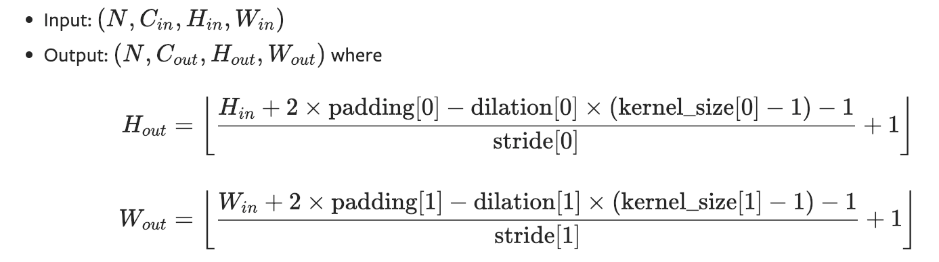
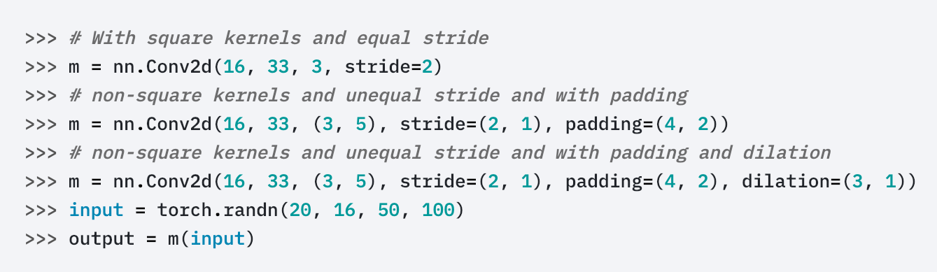
Conv2d

Slide 57
Conv1d,2d,3d
The parameters kernel_size, stride, padding, dilation can either be:
a single int – in which case the same value is used for the depth(, height and width) dimension
a tuple of three ints – in which case, the first int is used for the depth dimension, the second int for the height dimension and the third int for the width dimension

Slide 58
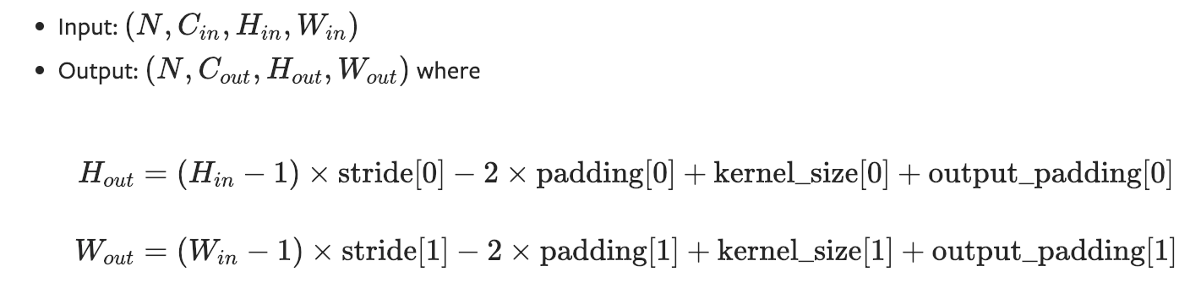
ConvTranspose
exchange forward and backward propagation
detail: https://github.com/vdumoulin/conv_arithmetic

Slide 59
Pooling Layers
MaxPool1d
MaxPool2d
MaxPool3d
MaxUnpool1d
MaxUnpool2d
MaxUnpool3d
AvgPool1d
AvgPool2d
AvgPool3d
AdaptiveMaxPool1d
AdaptiveMaxPool2d
AdaptiveMaxPool3d
AdaptiveAvgPool1d
AdaptiveAvgPool2d
AdaptiveAvgPool3d

Slide 60
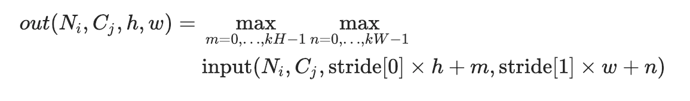
MaxPool
torch.nn.MaxPool2d(kernel_size, stride=None, padding=0, dilation=1, return_indices=False, ceil_mode=False)
In the simplest case, the output value of the layer with input size N,C,H,W),output (N,C,Hout​,Wout​) and kernel_size (kH,kW) can be precisely described as:

Slide 61
MaxPool
kernel_size – the size of the window to take a max over
stride – the stride of the window. Default value is kernel_size
padding – implicit zero padding to be added on both sides
dilation – a parameter that controls the stride of elements in the window
return_indices – if True, will return the max indices along with the outputs. Useful for torch.nn.MaxUnpool2d later
ceil_mode – when True, will use ceil instead of floor to compute the output shape

Slide 62
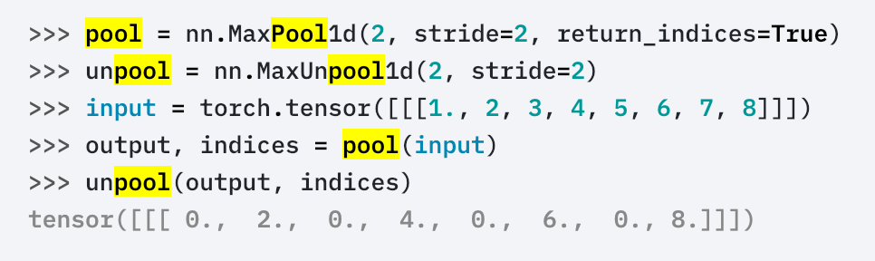
MaxUnpool
Computes a partial inverse of MaxPool1d.
MaxPool1d is not fully invertible, since the non-maximal values are lost.
MaxUnpool1d takes in as input the output of MaxPool1d including the indices of the maximal values and computes a partial inverse in which all non-maximal values are set to zero.

Slide 63
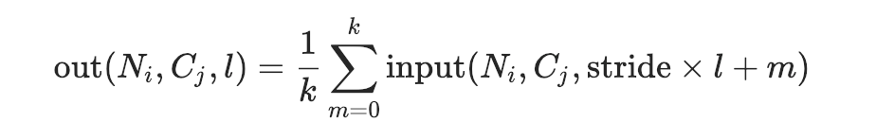
AvgPool
Applies a 1D average pooling over an input signal composed of several input planes.
In the simplest case, the output value of the layer with input size (N,C,L), output (N,C,Lout​) and kernel_size k can be precisely described as:

Slide 64
AvgPool
kernel_size – the size of the window
stride – the stride of the window. Default value is kernel_size
padding – implicit zero padding to be added on both sides
ceil_mode – when True, will use ceil instead of floor to compute the output shape
count_include_pad – when True, will include the zero-padding in the averaging calculation

Slide 65
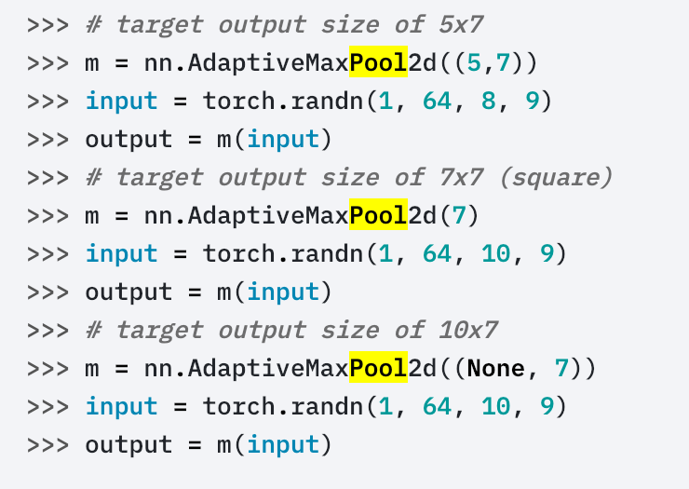
AdaptiveMaxPool
torch.nn.AdaptiveMaxPool2d(output_size, return_indices=False)

Slide 66
Recurrent layers
RNN
LSTM
GRU
RNNCell
LSTMCell
GRUCell

Slide 67
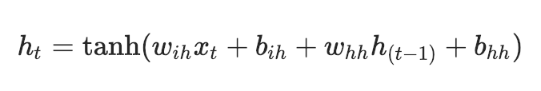
RNN
Applies a multi-layer Elman RNN with tanhtanh or ReLUReLU non-linearity to an input sequence.
For each element in the input sequence, each layer computes the following function:
where h_{t}​ is the hidden state at time t, x_{t}​ is the input at time t, and h_{(t−1)} is the hidden state of the previous layer at time t-1 or the initial hidden state at time 0. If nonlinearity is ‘relu’, then ReLU is used instead of tanh.

Slide 68
RNN
input_size – The number of expected features in the input x
hidden_size – The number of features in the hidden state h
num_layers – Number of recurrent layers. E.g., setting num_layers=2 would mean stacking two RNNs together to form a stacked RNN, with the second RNN taking in outputs of the first RNN and computing the final results. Default: 1
nonlinearity – The non-linearity to use. Can be either ‘tanh’ or ‘relu’. Default: ‘tanh’
bias – If False, then the layer does not use bias weights b_ih and b_hh. Default: True
batch_first – If True, then the input and output tensors are provided as (batch, seq, feature). Default: False
dropout – If non-zero, introduces a Dropout layer on the outputs of each RNN layer except the last layer, with dropout probability equal to dropout. Default: 0
bidirectional – If True, becomes a bidirectional RNN. Default: False

Slide 69
RNN
input of shape (seq_len, batch, input_size): tensor containing the features of the input sequence.
h_0 of shape (num_layers * num_directions, batch, hidden_size): tensor containing the initial hidden state for each element in the batch. Defaults to zero if not provided. If the RNN is bidirectional, num_directions should be 2, else it should be 1.

Slide 70
RNN
output of shape (seq_len, batch, num_directions * hidden_size): tensor containing the output features (h_k) from the last layer of the RNN, for each k.
h_n (num_layers * num_directions, batch, hidden_size): tensor containing the hidden state for k = seq_len.

Slide 71
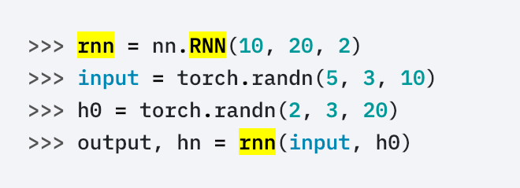
RNN

Slide 72
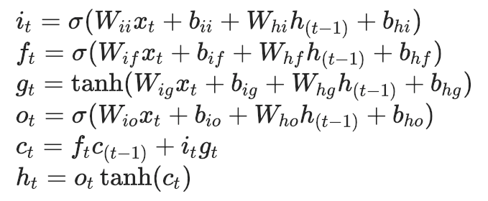
LSTM
where h_{t}​ is the hidden state at time t, ct​ is the cell state at time t, x_{t}​ is the input at time t, h_{(t−1)}​ is the hidden state of the layer at time t-1 or the initial hidden state at time 0, and i_{t}​, f_{t​}, g_{t}​, o_{t}​ are the input, forget, cell, and output gates, respectively.

Slide 73
LSTM
input_size – The number of expected features in the input x
hidden_size – The number of features in the hidden state h
num_layers – Number of recurrent layers. E.g., setting num_layers=2 would mean stacking two LSTMs together to form a stacked LSTM, with the second LSTM taking in outputs of the first LSTM and computing the final results. Default: 1
bias – If False, then the layer does not use bias weights b_ih and b_hh. Default: True
batch_first – If True, then the input and output tensors are provided as (batch, seq, feature). Default: False
dropout – If non-zero, introduces a Dropout layer on the outputs of each LSTM layer except the last layer, with dropout probability equal to dropout. Default: 0
bidirectional – If True, becomes a bidirectional LSTM. Default: False

Slide 74
LSTM
input of shape (seq_len, batch, input_size): tensor containing the features of the input sequence. The input can also be a packed variable length sequence.
h_0 of shape (num_layers * num_directions, batch, hidden_size): tensor containing the initial hidden state for each element in the batch. If the RNN is bidirectional, num_directions should be 2, else it should be 1.
c_0 of shape (num_layers * num_directions, batch, hidden_size): tensor containing the initial cell state for each element in the batch.
If (h_0, c_0) is not provided, both h_0 and c_0 default to zero.

Slide 75
LSTM
output of shape (seq_len, batch, num_directions * hidden_size): tensor containing the output features (h_{t)} from the last layer of the LSTM, for each t.
h_n of shape (num_layers * num_directions, batch, hidden_size): tensor containing the hidden state for t = seq_len.
c_n (num_layers * num_directions, batch, hidden_size): tensor containing the cell state for t = seq_len

Slide 76
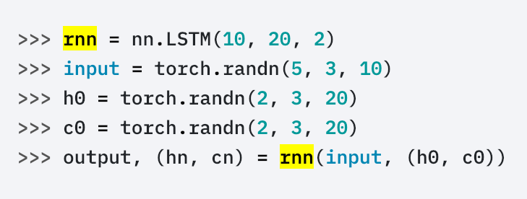
LSTM

Slide 77
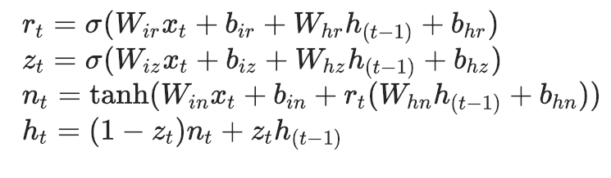
GRU
Applies a multi-layer gated recurrent unit (GRU)
RNN to an input sequence.
For each element in the input sequence, each layer computes the following function:
where h_{t​} is the hidden state at time t, x_{t}​ is the input at time t, h_{(t−1)​} is the hidden state of the layer at time t-1 or the initial hidden state at time 0, and r_{t}​, z_{t​}, n_{t}​ are the reset, update, and new gates, respectively.

Slide 78
GRU
input_size – The number of expected features in the input x
hidden_size – The number of features in the hidden state h
num_layers – Number of recurrent layers. E.g., setting num_layers=2 would mean stacking two GRUs together to form a stacked GRU, with the second GRU taking in outputs of the first GRU and computing the final results. Default: 1
bias – If False, then the layer does not use bias weights b_ih and b_hh. Default: True
batch_first – If True, then the input and output tensors are provided as (batch, seq, feature). Default: False
dropout – If non-zero, introduces a Dropout layer on the outputs of each GRU layer except the last layer, with dropout probability equal to dropout. Default: 0
bidirectional – If True, becomes a bidirectional GRU. Default: False

Slide 79
GRU
input of shape (seq_len, batch, input_size): tensor containing the features of the input sequence.
h_0 of shape (num_layers * num_directions, batch, hidden_size): tensor containing the initial hidden state for each element in the batch. Defaults to zero if not provided. If the RNN is bidirectional, num_directions should be 2, else it should be 1.

Slide 80
GRU
output of shape (seq_len, batch, num_directions * hidden_size): tensor containing the output features h_t from the last layer of the GRU, for each t.
h_n of shape (num_layers * num_directions, batch, hidden_size): tensor containing the hidden state for t = seq_len

Slide 81
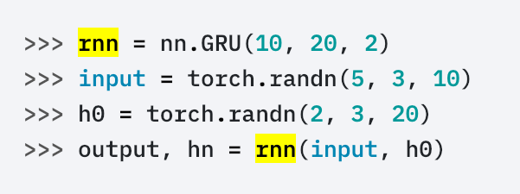
GRU

Slide 82
RNN&RNNCell
RNN
Full Sequence
The former is more complete and easier to package
RNN layer is implemented by calling RNNCell
RNN Cell
One time step
the latter is more flexible

Slide 83
Dropout layers
Dropout
Dropout2d
Dropout3d
AlphaDropout

Slide 84
Normalization layers
BatchNorm1d
BatchNorm2d
BatchNorm3d
InstanceNorm1d
InstanceNorm2d
InstanceNorm3d
LocalResponseNorm

Slide 85
Non-linear Activations
ReLU
ReLU6
ELU
SELU
PReLU
LeakyReLU
Threshold
Hardtanh
Sigmoid
Tanh
LogSigmoid
Softplus
Softshrink
Softsign
Tanhshrink
Softmin
Softmax
Softmax2d
LogSoftmax

Slide 86
Loss functions
L1Loss
MSELoss
CrossEntropyLoss
NLLLoss
PoissonNLLLoss
KLDivLoss
BCELoss
BCEWithLogitsLoss
MarginRankingLoss
HingeEmbeddingLoss
MultiLabelMarginLoss
SmoothL1Loss
SoftMarginLoss
MultiLabelSoftMarginLoss
CosineEmbeddingLoss
MultiMarginLoss
TripletMarginLoss

Slide 87
Padding Layers
ReflectionPad2d
ReplicationPad2d
ReplicationPad3d
ZeroPad2d
ConstantPad2d

Slide 88
Sparse layers
Embedding
EmbeddingBag

Slide 89
Distance functions
CosineSimilarity
PairwiseDistance

Slide 90
Vision layers
PixelShuffle
Upsample
UpsamplingNearest2d
UpsamplingBilinear2d

Slide 91
Utilities
clip_grad_norm
weight_norm
remove_weight_norm
PackedSequence
pack_padded_sequence
pad_packed_sequence
pad_sequence
pack_sequence

Slide 92
Model work choices
Choice of last layer
For a regression, a linear layer generating a scalar value; for a vector regression, a linear layer generating more than one scalar value;
Choice of loss function
Optimization

Slide 93
Baseline model
Problem type | Activation function | Loss function
Binary classification | Sigmoid | CrossEntropyLoss
Multi-class classification | Softmax | CrossEntropyLoss
Multi-label classification | Sigmoid | CrossEntropyLoss
Regression | None | MSE
Vector regression | None | MSE

